Slide 1
SECURE APPLICATION FOR FISHERIES
Company Guide:
Mr. Kadiri Praveen Kumar
CEO
B-AIM, vizag
Project By: Jasti Bhargav
(170030475)
University Guide:
Mr. V. Shourie Reddy
Regional Manager
KL University , Vizag

Slide 2
Abstract
In view of the security uncertainty in internet This module is designed in such a way that it should provide security to not only to website but also to the source code of website. Here in this project we are going to create a website and provide security for that we are going to create a login/signup module which will collect user data and store it in website members data. Then we will create individual member module to keep track of orders, addresses and we can even update our personal info. Then keep track of ip addresses we will create a analytics page which is only available to admin to get ip address of user and their location and we can even get a monthly report. Finally to stop copying of data and source code we will block right click.

Slide 3
Objective
The aim of this project is to create a security module which will help us in knowing who is accessing our website and get their information.

Slide 4
Literature survey
There are tools known as word press , wix to create websites
WordPress is having its own security features like blocking ip’s
But in wix there are no security features and not even blocking ip’s , so we are going to make ip blocking by using user data.

Slide 5
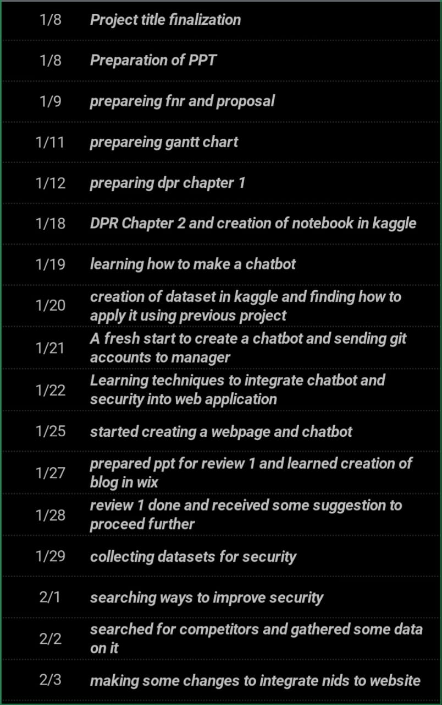
FNR

Slide 6
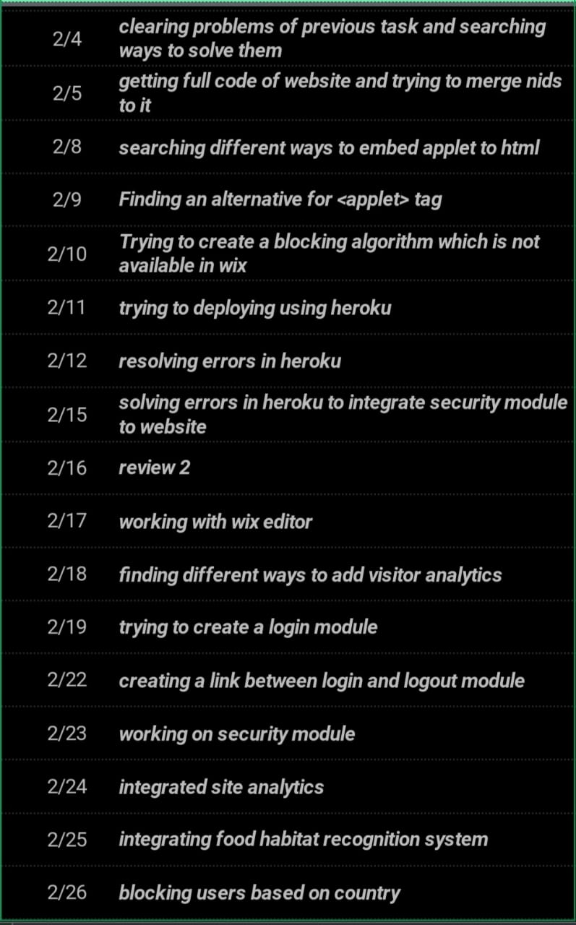
FNR

Slide 7
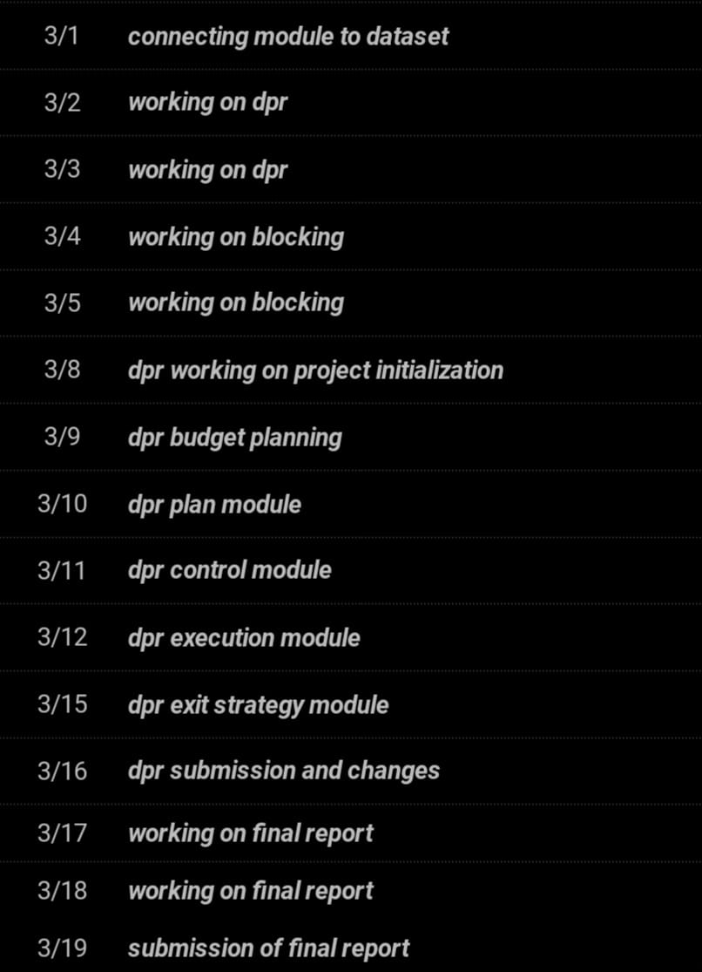
FNR

Slide 8
Tools used
Corvid , Wix

Slide 9
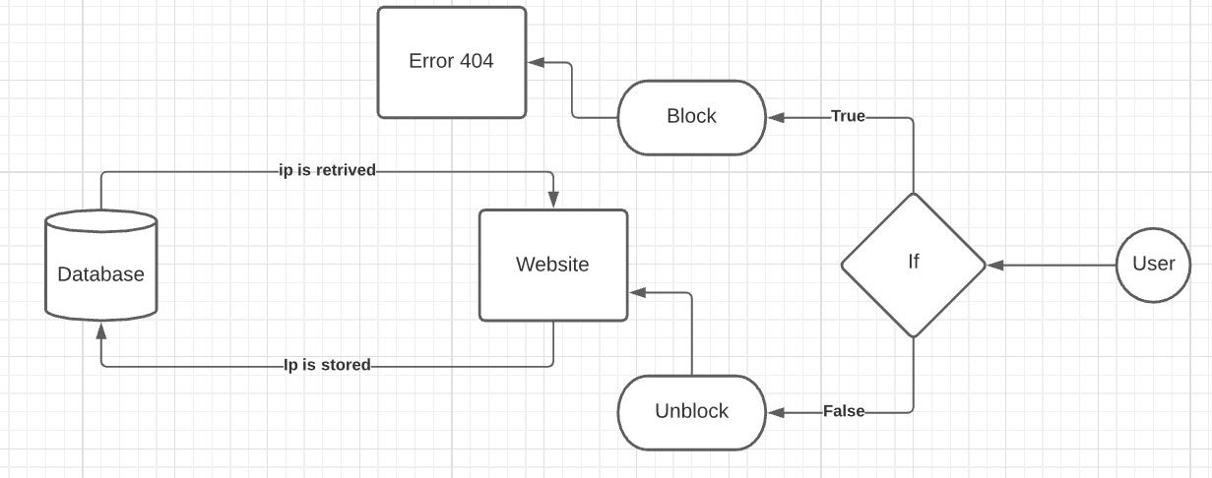
Block diagram

Slide 10
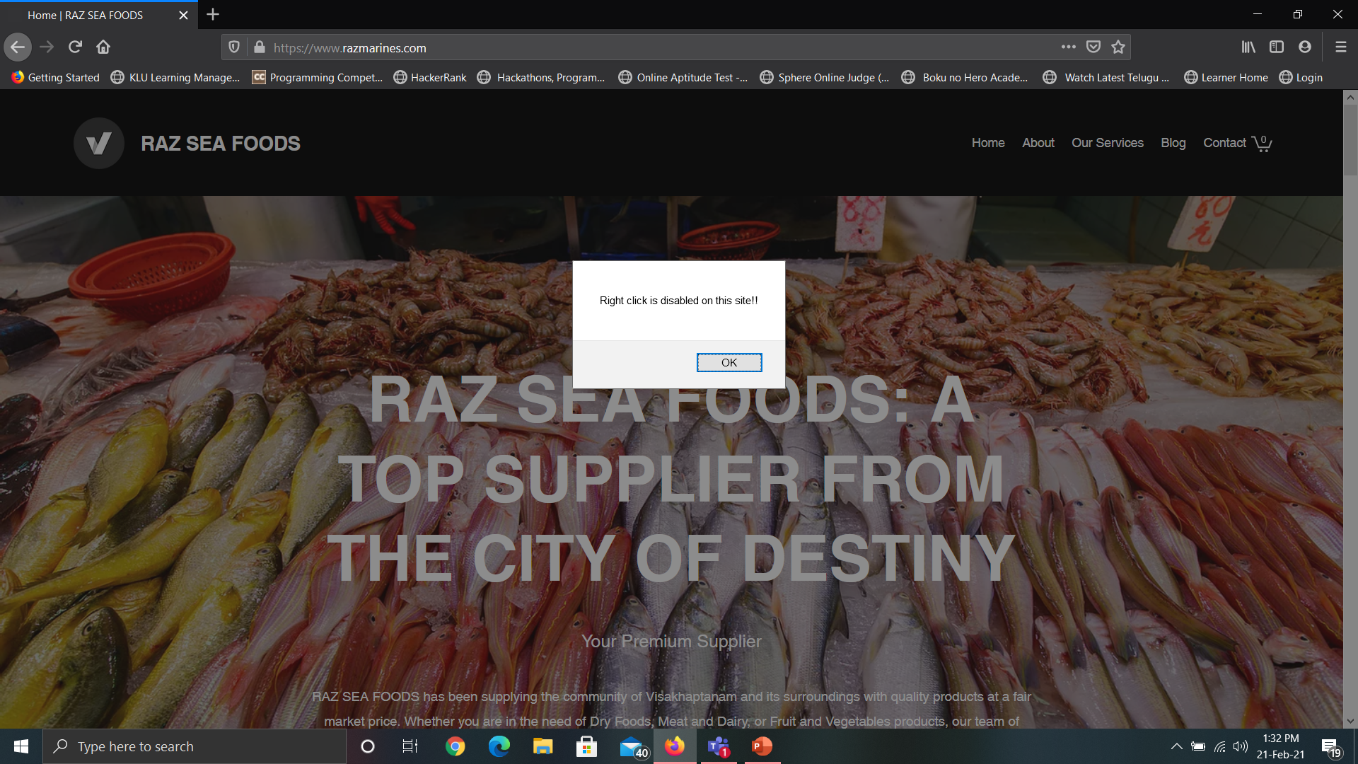
Website right click blocking

Slide 11
Website right click blocking
In this module as we can see that by using ajax and javascript we can block right click in our website.
The main purpose of this module is to prevent any unknown person seeing our source code.

Slide 12
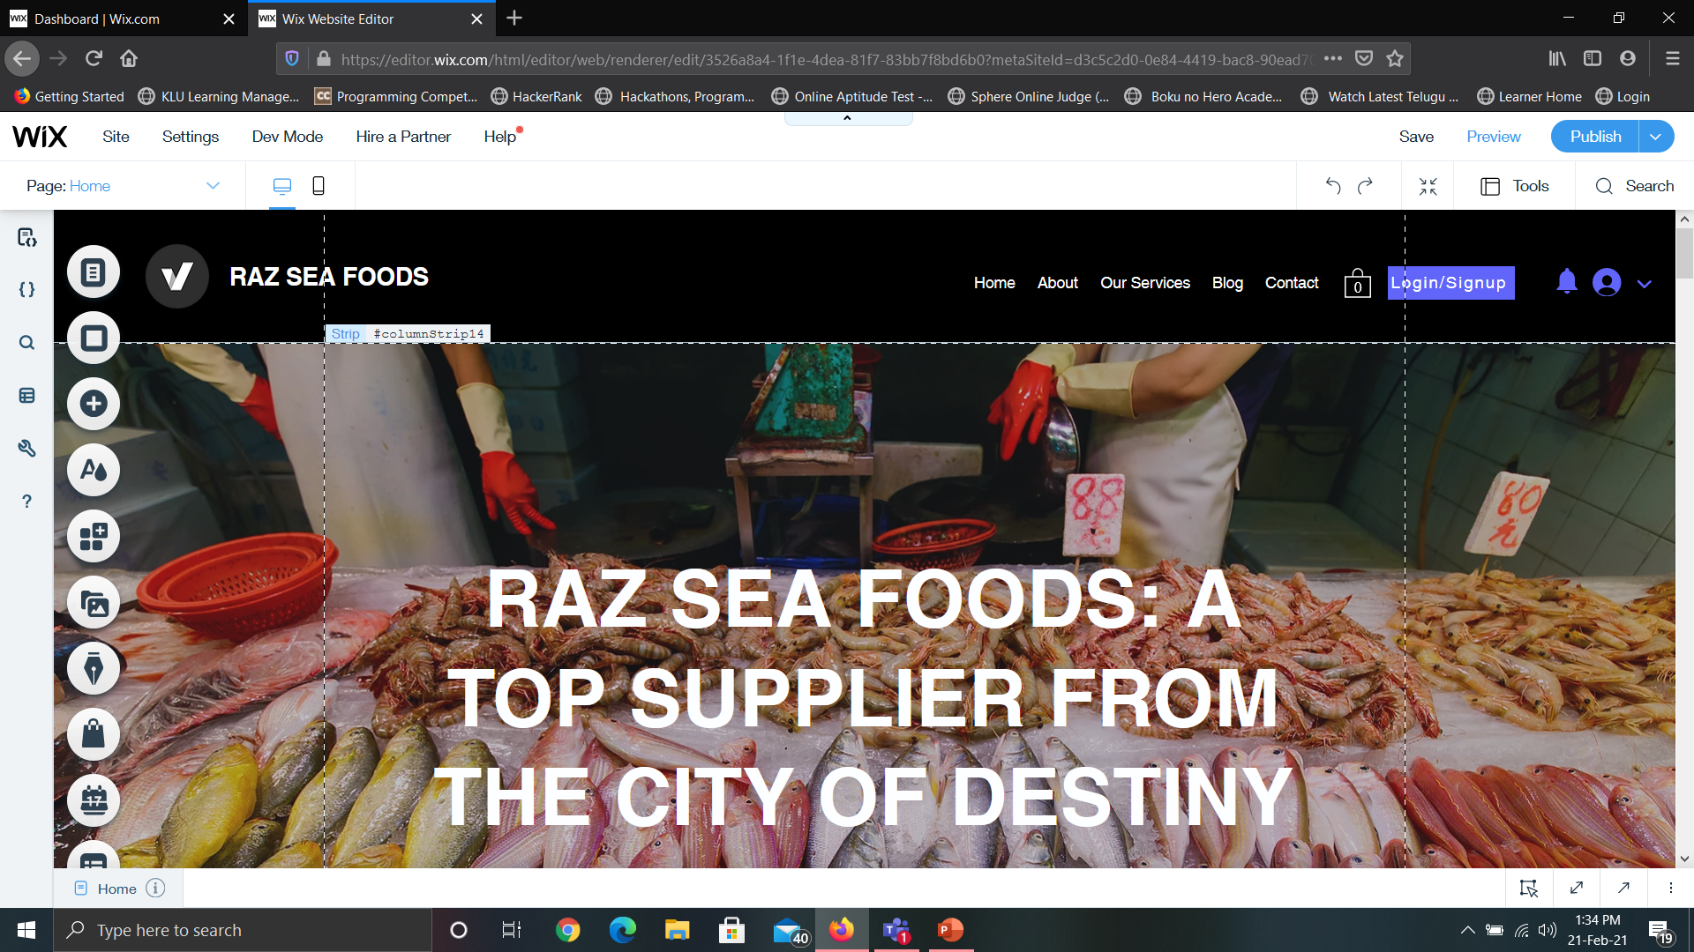
Signup/login module

Slide 13
Signup/login module
This module will help us in gathering user information.
Not only that we can relate their order in their particular group so that we can clearly track their order.

Slide 14
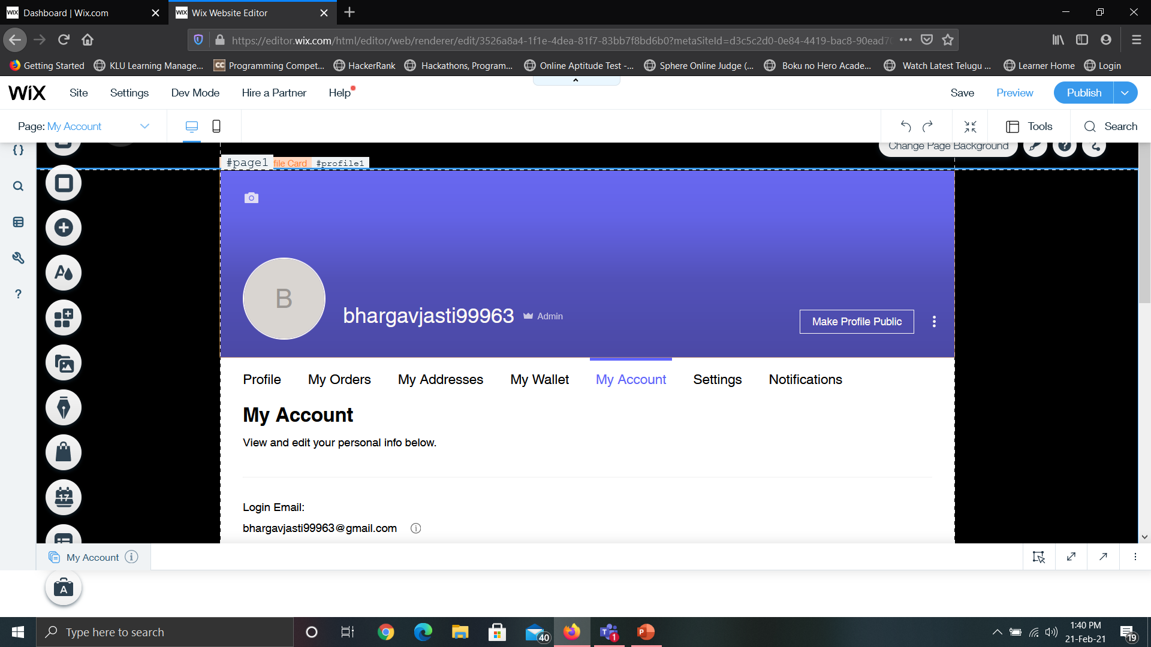
Member module

Slide 15
Member module
In this module we will be able to see each member personal information.
Not only that we can even update that information in that module not only that we can even track addresses, orders and many more until we are satisfied.

Slide 16
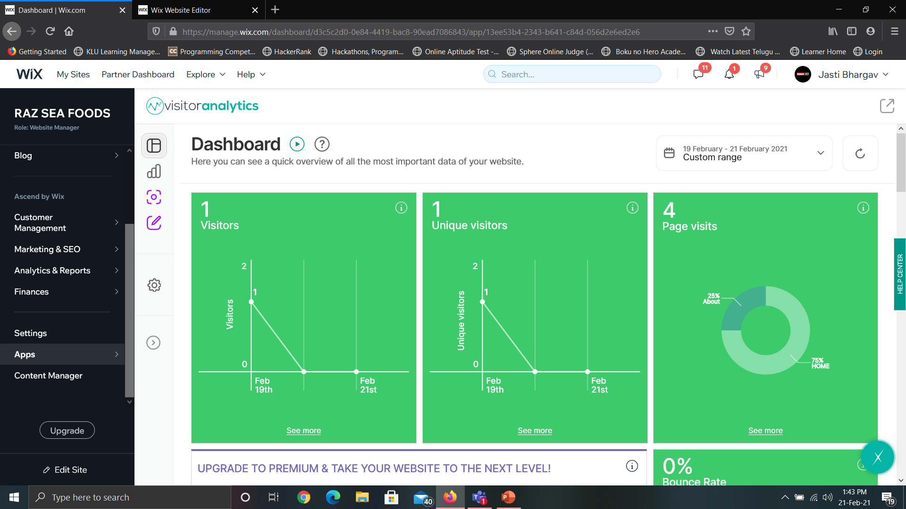
Analytics

Slide 17
analytics
As we can see above this module will be really helpful in realtime because when we run our website in realtime then we can get visitor analytics from here
We can get the location , ip address of each user by using that we can gather more information about them

Slide 18
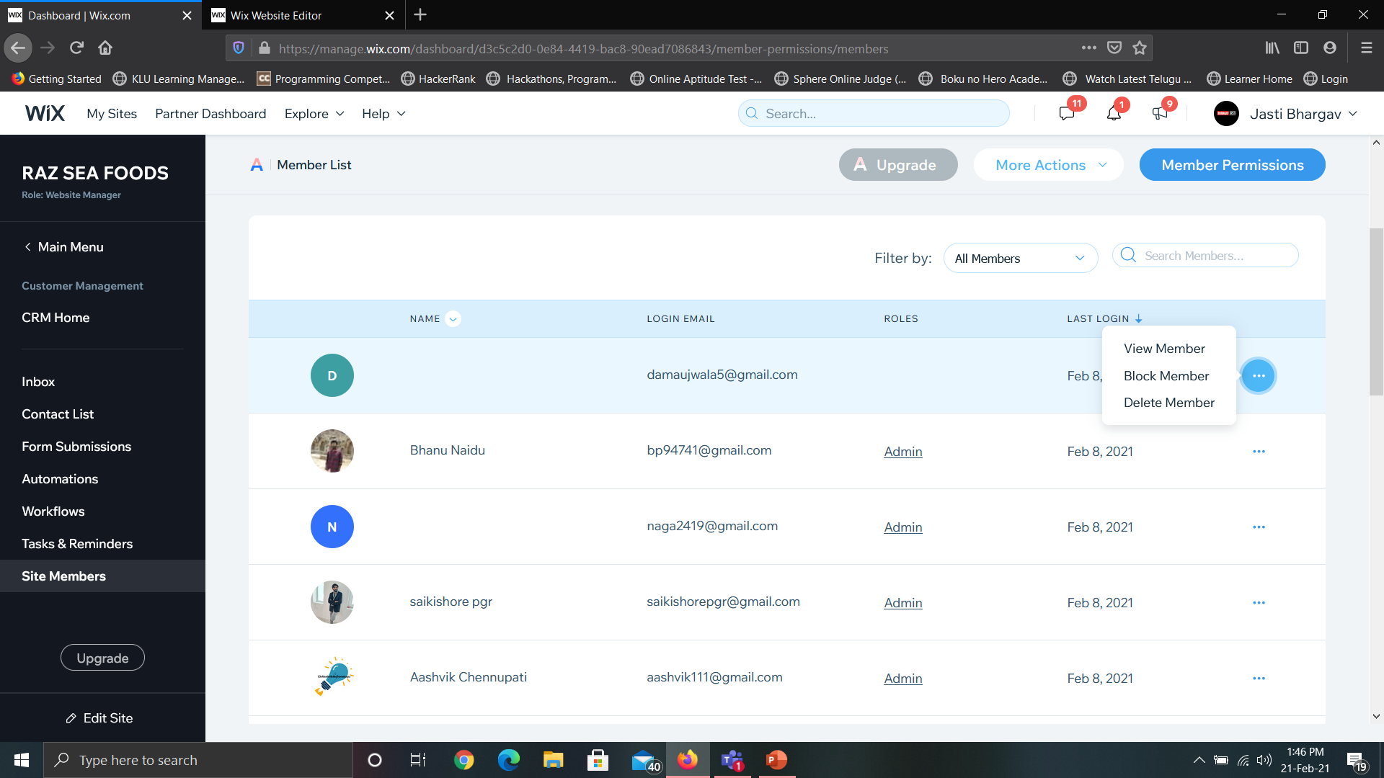
Site members and blocking

Slide 19
Site members and blocking
As we can see from above any user who signup in our website will appear in sitemembers page then we will be able to block them
We can even unblock them by going to blocked members page

Slide 20
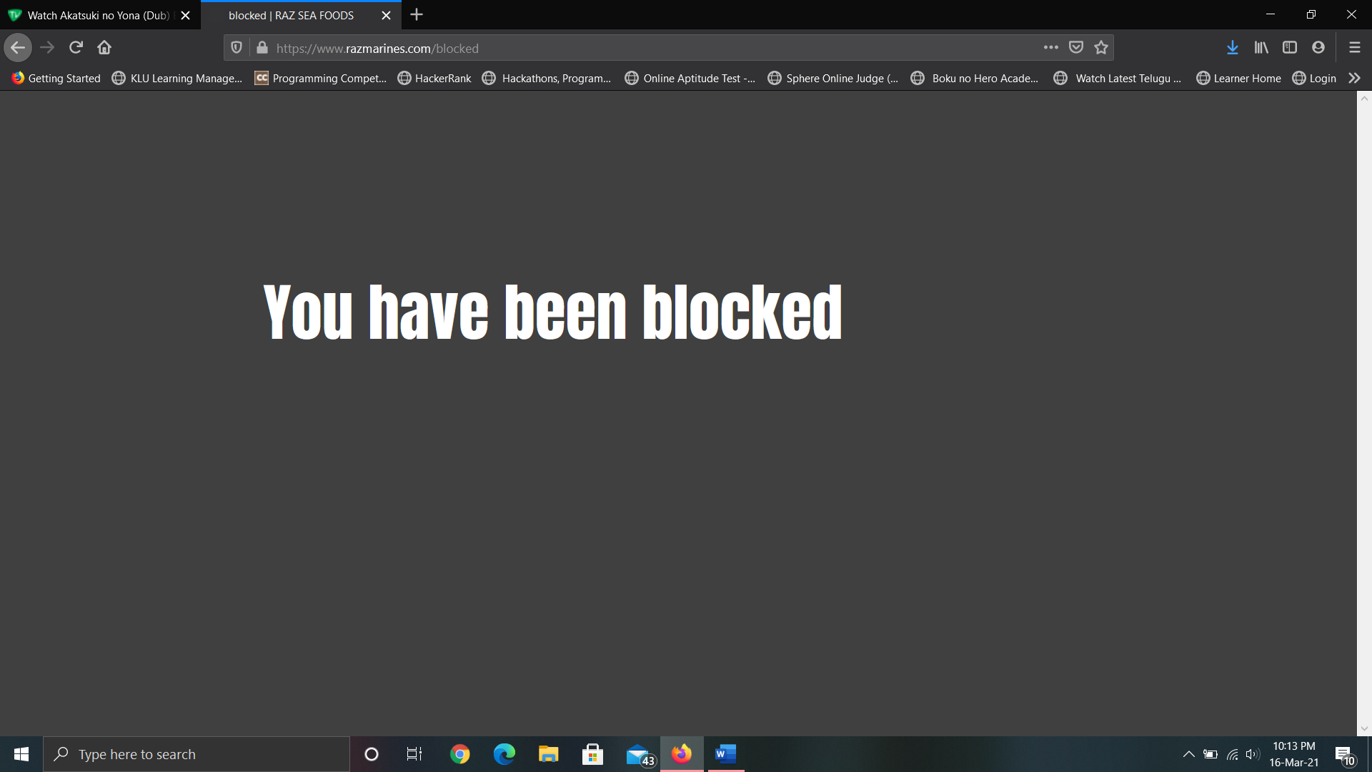
IP Based blocking

Slide 21
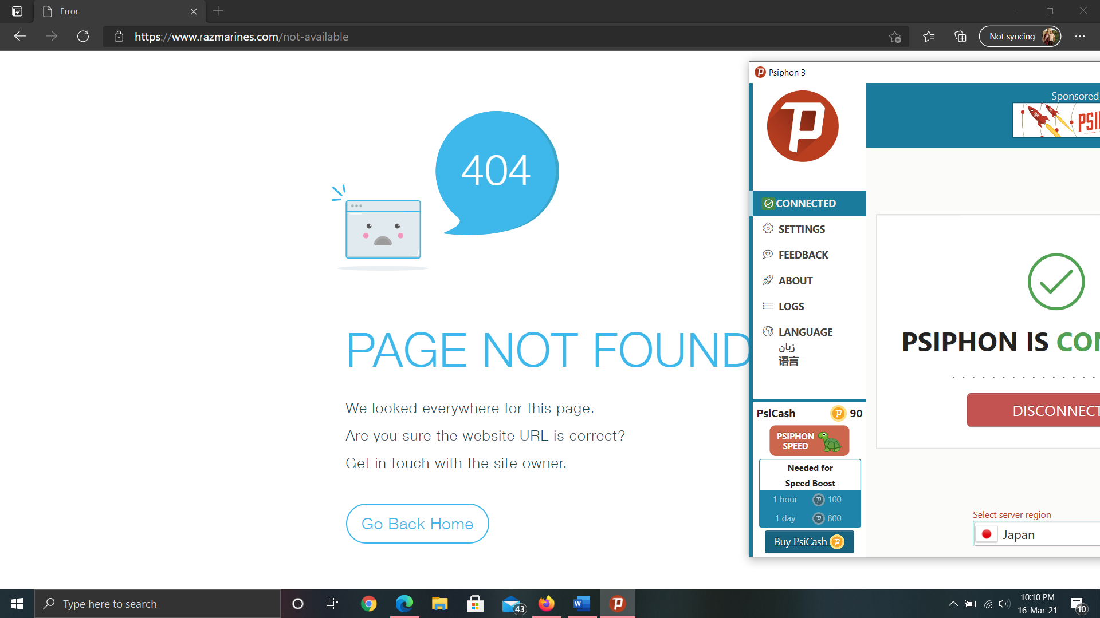
Geo Blocking

Slide 22
Conclusion
Websites are being used in many sectors now a days, by connecting to different domain we can get our security and not only that we can even provide security by blocking the right click and getting user information helps us in identifying them quick and not only that for the security purpose of websites it should contain analytics report which consists of ip addresses of user and their location this helps us in getting accurate information about user.

Slide 23
references
https://www.wix.com/velo/forum/community-discussion/solved-block-an-ip-and-redirect-to-another-page
https://www.geeksforgeeks.org/how-to-get-client-ip-address-using-javascript/
https://ieeexplore.ieee.org/document/5385128
https://www.wpbeginner.com/wp-tutorials/how-to-block-ip-addresses-in-wordpress/

Slide 24
Learning outcome
During this practice school internship, I have learnt how effectively we can use A.I in fisheries sector.
I have learnt how to apply security in websites.
I have gained some company experience during this internship like working in different timings i.e. sometimes morning shifts and sometimes night shifts, interacting directly with the CEO and managers. This helps me a lot to sustain in IT industry, since I am moving into it.
I also worked as digital marketing lead, where I’ve created some blogs related to fisheries and promoted them by representing our company. This helped me to gain some knowledge on marketing strategies that companies use to promote their products.
I also worked as technical team lead where I have assisted my team members during their projects. This helped me to gain strong knowledge on building software oriented projects.

Slide 25
Feedback on practice school
The PS program is very useful in such a way that it helped to get some industrial knowledge and also it helped me how to interact with company people. The company CEO is very friendly and kind, he will interact with each and every employee weekly and will ask for progress of project and also for the issues the employees were facing.

Slide 26
Thank You

